Slide 1
Azure Load Balancer

Slide 2
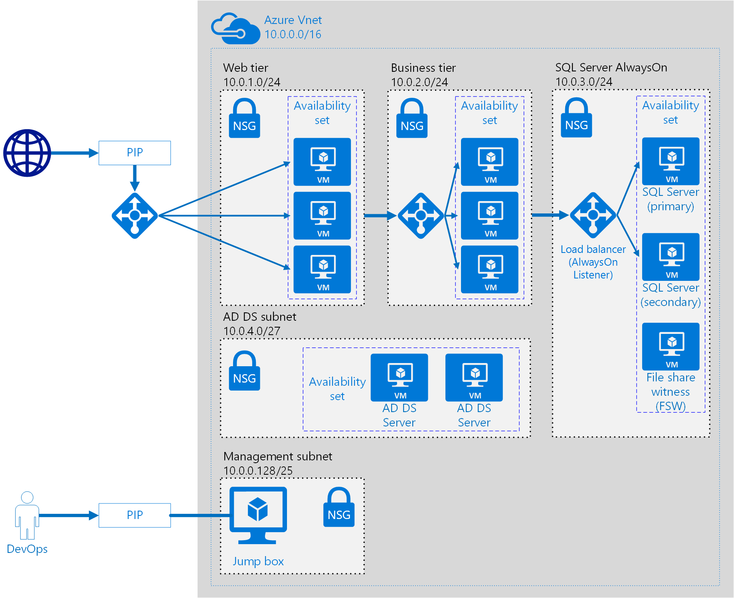

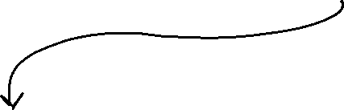



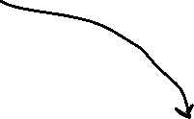



Slide 3





Azure Load Balancer
High availability and network performance to your applications.
It is an OSI layer 4 (TCP and UDP) load balancer that distributes inbound traffic to backend resources using load balancing rules and health probes.
Backend Pool
Frontend
Load Balancing Rules
And health probes

Slide 4







Public Load Balancer

Slide 5


Internal Load Balancer

Slide 6
Load Balancer SKUs
Basic
Standard

Slide 7
Backend Pools
 | Standard SKU | Basic SKU
Backend Pool endpoints | Any VM in a single virtual network, including a blend of VMs, availability sets and VM scale sets | VMs in a single availability set or VM scale set

Slide 8
Load Balancer Rules
Used to define how the traffic is distributed to the backend pool.

Slide 9












Session Persistence

Slide 10















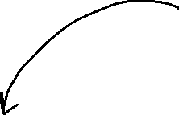





Health Probes
It allows the load balancer to monitor the status of your app.

Slide 11
















Hands-On
Load Balancer –
3 VMs
1st VM – IIS Web Server –
2nd VM – IIS Web Server –
3rd VM – Jump Box VM –

